Slide 1
Basic Concurrency

Slide 2
Overview of Software Scheduling Challenge

Slide 3
Scheduling Challenge
How to share the CPU’s time among multiple software activities
Typical embedded system has multiple activities which must be managed
Some performed by peripheral hardware, others performed by software on CPU
These activities have timing requirements, some more critical than others
Example: reading switches, scanning LEDs
We want to make one CPU core appear to do many things concurrently (at the same time)
Even with a multicore processor, we have more software activities than processor cores
How do we share the CPU’s time among the software activities? How do we simulate concurrency among software activities?
➔ How do we perform task scheduling?

Slide 4
Scheduling Roadmap
Starter Program
Better Modularity
Less CPU Overhead
Task-Based Program
Better Responsiveness
Using Hardware Peripherals
Interrupts
Shorter Tasks
Removing Polling and Busy-Waiting
Task Prioritization
Task Preemption

Slide 5

Flashing Light Example
Slow/Fast
Embedded System
RGB/BW
Slow/Fast
RGB/BW
Pressed
LED Output
R
G
B
R
G
R
G
B
R
Time
What determines the delay between an input event (pressing a button) and the output changing (different LED flashing pattern)?

Slide 6
Ideal Schedule – Event-Driven
Switch Inputs
Switch 1 pressed
Task_Read_ Switches
Task_Flash
Task_RGB
LED Output
R
G
B
R
G
R
G
B
R
Time

Slide 7
V1 Flasher Program

Slide 8
Examining the Problem
V1
Switch Inputs
Switch 1 pressed
Delay
LED Output
R
G
B
R
G
B
Flashing White
R
G
B
Time
Consider LED scanning program
Problems:
Have to hold down switch until program polls (reads) it, can be a long delay
Some switch presses are ignored
Program reads buttons once per LED scan cycle
LED scan cycle takes a long time to complete

Slide 9
Tasks: What and Why?
Better code structure simplifies development
Task: Code which performs given activity, or closely related set of activities
Lights LEDs
Reads switches
Simplifies development (compare with backpacks and bags)
Groups related functionality together
Separates unrelated functionality
Improves debugging, maintenance, enhancement
Each task has a task root function
Task root function may call other functions as needed

Slide 10
Using Tasks for the LED Scanner
V2
Switches
Task_Read_ Switches
g_w_delay
g_flash_LED
g_RGB_delay
Task_Flash
Task_RGB
RGB LEDs

Slide 11
Tasks Communicate Through Shared Variables
Switch Inputs
Switch 1 pressed
Flasher
Task_Read _Switches
g_Flash_LED
0
1
Task_Flash
Task_RGB
LED Output
B
Time
Task_Read_Switches writes to variable g_Flash_LED
Task_Flash reads g_Flash_LED, decides to flash LEDs

Slide 12
V2 Flasher Program

Slide 13
V2 Flasher Program
Switches
Tasks are run at same rate – once per loop iteration. Simplifies later scheduling analysis: N_{Task} = 1

Slide 14
Task Execution Schedule
V2
Switch Inputs
Switch 1 pressed
Task_Read _Switches
Delay
Task_Flash
Task_RGB
LED Output
R
G
B
R
G
B
R
G
B
Time
Flasher is a task scheduler, calls each task’s root function. Never stops running.
Each task runs to completion and then returns control to the scheduler (Flasher)
Maximum delay from pressing switch to LEDs responding occurs if we press switch just after TASK_Read_Switches finishes
Max. delay = Σ T_{Task}N_{Task =} sum of (task execution time * # of runs of that task over given time period)
This is a worst-case bound which we can tighten up

Slide 15
Consider Delays within Tasks to Improve Timing Analysis
Switch Inputs
Switch 1 pressed
Flasher
Task_Read _Switches
τ_{RS to Output}
τ_{Flash to Output}
g_Flash_LED
0
1
Task_Flash
Task_RGB
LED Output
B
Time
Task_Read_Switches changes variable output after a delay of τ_{RS to Output}
Task_Flash changes LED output after a delay of τ_{Flash to Output}

Slide 16
Task Execution Schedule
V2
Switch Inputs
Switch 1 pressed
Task_Read _Switches
Delay
Task_Flash
Task_RGB
LED Output
R
G
B
R
G
B
R
G
B
Time
We can reduce the delay until Task_Read_Switches runs by using an interrupt (event-triggering instead of polling)

Slide 17

Interrupt Concepts
Interrupt
A signal which indicates a particular event happened (e.g. switch was pressed)
System behavior
CPU is running program’s “main-line” code – in main function or one of its subroutines, or sub-subroutines, etc.
The interrupt forces the CPU to put the code it’s running now “on hold” and instead run a special “Interrupt Service Routine” (ISR) which handles the event
After the ISR finishes, the CPU goes back to executing the main-line code
You will never call an ISR function from your code
Event: Switch
ISR: Switch-Reading Code
Main-line: LED- Scanning Code
Interrupt requested
Interrupt requested
Interrupt requested

Slide 18
Program Structure with Tasks and ISR
V3
Switches
Interrupt Service Routine
g_w_delay
g_flash_LED
g_RGB_delay
Task_Flash
Task_RGB
RGB LEDs

Slide 19
V3 Flasher Program

Slide 20
V3 Flasher Program

Slide 21
Two Tasks and Switch ISR
V3
Switch Inputs
Switch 1 pressed
PORTD_ IRQHandler
Delay
Task_Flash
Task_RGB
LED Output
R
G
B
R
G
B
R
G
B
Time
Limited improvement from ISR, since Task_RGB resumes executing after ISR completes
Task_RGB is still “in the way” after the ISR
Example of a non-preemptive system: tasks cannot preempt each other
Max. delay = Σ T_{Task}N_{Task} +Σ T_{ISR}N_{ISR}

Slide 22
How to Improve Responsiveness?
More tests?
Add more tests within the tasks?
Allow task to exit early
Bad idea
Mixes scheduler in with more of the task code
Extra code to execute
Harder to maintain

Slide 23
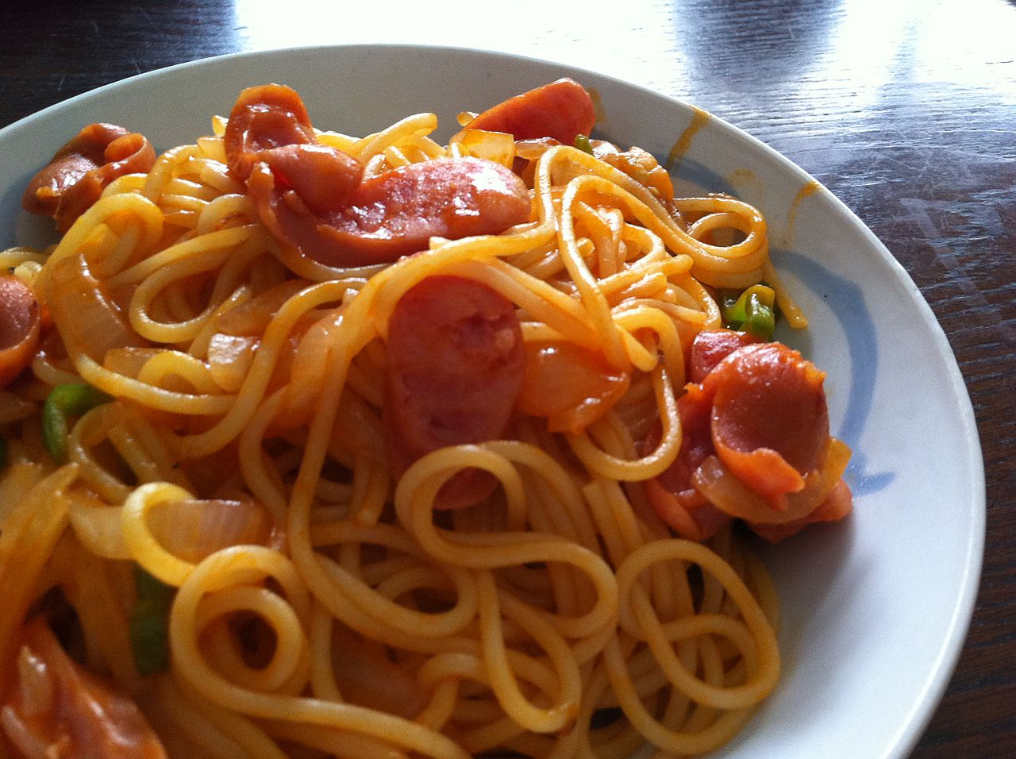
How to Improve Responsiveness?
Test in Delay function?
Modify Delay function to exit early if the calling function shouldn’t be running any more?
More modular … ?
Bad idea
Mixes scheduler in with more of the task code
Extra code to execute
Harder to maintain
Spaghetti Code!
By Ishikawa Ken - ナポリタン！ #shoot1230, CC BY-SA 2.0,
https://commons.wikimedia.org/w/index.php?curid=27529943

Slide 24


Embedded Software is Often Kept Alive As Long As Possible
People will try to keep your software alive much longer than you expect.
Which version of code would you rather work with?
Good to simplify and standardize activities which touch the code
Understanding, testing, maintaining (changing, fixing, enhancing)
Cenegenics Elite Health
Alfredo Estrella/AFP/Getty

Slide 25
How to Improve Responsiveness?
Move more work into ISR?
Interrupt service routine
Task or main-line code
Option 3: Long ISR
Option 2: Medium ISR
Option 1: Short ISR
Did switch 1 change?
Determine new value of switch 1
Task_RGB: Light LEDs in RGB sequence
Update g_flash_LED
Optional: Update LEDs immediately
Did switch 2 change?
Determine new value of switch 2
Update g_RGB_delay, g_w_delay
Task_Flash: Flash LEDs white and black

Slide 26
Reduce Response Time with Finite State Machines
Rewrite each long task so it returns control to scheduler sooner
Each call to the task’s root function lets it execute the code of one state
Red On
and Wait
Green On
and Wait
Reset
Time-Out
Blue On
and Wait
Time-Out
Time-Out

Slide 27
V4 Flasher Code
Split long tasks into multiple states

Slide 28
V4 Flasher Code
Split long tasks into multiple states

Slide 29
Execution Schedule with RGB FSM
V4
Switch Inputs
Delay
Switch 1 pressed
Task_Read _Switches
Task_Flash
Task_RGB
LED Output
R
G
B
R
G
R
G
B
R
Time
Maximum delay from pressing switch to LEDs responding is now much shorter (~1/3)
Max. delay = Σ T_{Task_State}N_{Task}
For better responsiveness, reduce state length further
Note: we are polling the switches again (with Task_Read_Switches) to allow direct comparison (only one change)
Minor FSM execution time overhead, but acceptable here
And software is well-organized into tasks

Slide 30
Use Hardware to Save CPU Time
Delay function uses busy-wait loop to delay program for fixed amount of time
Improvement:
Use hardware timer to track that time
Software can poll that timer to determine if time delay is over
Poll timer periodically, based on acceptable overhead and required timing precision
More frequent polling: more software overhead, less timing error
ST_RED
ST_RED_ WAIT
ST_GREEN
Reset
Time-Out
Time-Out
ST_BLUE_ WAIT
ST_GREEN_WAIT
ST_BLUE
Time-Out

Slide 31
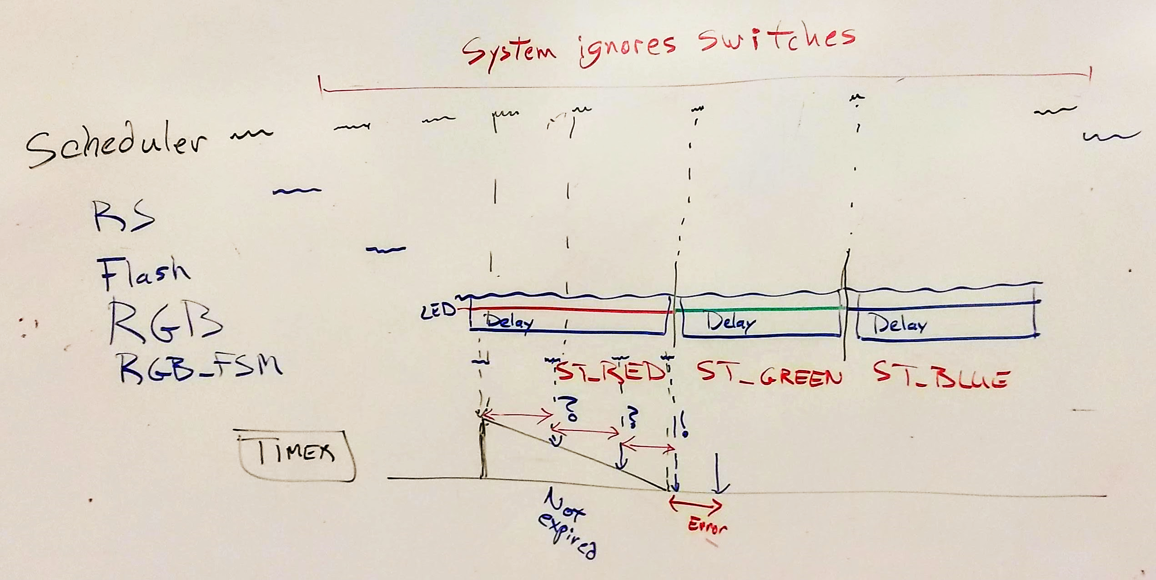

Slide 32
Task_Flash

Slide 33
Execution Schedule with FSM and HW Timer
V5
Switch Inputs
Switch 1 pressed
Task_Read _Switches
Task_Flash
Task_RGB
LED Output
R
G
B
R
G
G
B
R
G
Time
All waiting states execute and return very quickly now
Scheduler runs much more frequently
Max. delay = Σ T_{Task_State}N_{Task}
Use logic analyzer to see how often scheduler runs. About 200 kHz, period < 5 µs

Slide 34
Comparing Response Times
Switch Inputs
Switch 1 pressed
Delay
Starter Code
LED Output
R
G
B
R
G
B
R
G
B
Task_Read _Switches
Cooperative Tasks
Task_Flash
Task_RGB
LED Output
R
G
B
R
G
B
R
G
B
PORTD_ IRQHandler
Cooperative Tasks and Switch ISR
Task_Flash
Task_RGB
LED Output
R
G
B
R
G
B
R
G
B
Task_Read _Switches
Cooperative FSM Tasks
Task_Flash
Task_RGB
LED Output
R
G
B
R
G
R
G
B
R
Cooperative FSM Tasks and Hardware Timer
Task_Read _Switches
Task_Flash
Task_RGB
LED Output
R
G
B
R
G
G
B
R
G
Notes:
Consider LED scanning program
Problems:
Some switch presses are ignored
Have to hold down switch until program polls (reads) it, can be a long delay
Program reads buttons once per LED scan cycle
LED scan cycle takes a long time to complete

Slide 35
Another Look at Delays between Tasks
Switch Inputs
Switch 1 pressed
Task_Read _Switches
T₁
T₂
g_Flash_LED
0
1
Task_Flash
Task_RGB
LED Output
B
Time
We reduced T₂ by shortening the longest task states
So let’s reduce T₁ by using an interrupt

Slide 36
Execution Schedule with Switch Interrupt Added
V6
Switch Inputs
Switch 1 pressed
PORTD_ IRQHandler
Task_Flash
Task_RGB
LED Output
R
G
B
R
G
R
G
B
Time
Now states are shorter, so response time is far better
Max. delay = Σ T_{Task_State}N_{Task} + Σ T_{ISR}N_{ISR}
Use logic analyzer to see scheduler runs about 300 kHz! Period ~ 3 µs

Slide 37
A Closer Look at the Timing
Switch 1 press -> Flash LEDs
Switch 1 release -> Sequence LEDs
Switch Inputs
Switch 1 pressed
PORTD_ IRQHandler
Code a roommate added to make money
Task_Flash
Task_RGB
Task_Bitcoin
LED
RGB,OK
RGB, Wrong
?
Flash, OK
Flash, Wrong
?
RGB,OK
Time
Delay depends on where task inputs are read, outputs are written
In worst case, all inputs are read at beginning, all outputs are written at end, so need to add another run of the task (N+1)
Maximum delay depends on all other tasks in system
Press = T_{ISR}+T_{Flash} – ε+ T_{RGB} + T_{Bitcoin}+ T_{Flash} = T_{ISR} + 2*T_{Flash} – ε + T_{RGB +} T_{Bitcoin}
Release = T_{ISR} + T_{RGB} – ε + T_{Bitcoin} + T_{Flash} +T_{RGB} = T_{ISR} + T_{Flash} + 2*T_{RGB} – ε + T_{Bitcoin}

Slide 38
An Improvement: Task Priorities
Switch 1 press -> Flash LEDs
Switch 1 release -> Sequence LEDs
Switch Inputs
Switch 1 pressed
PORTD_ IRQHandler
Task_Flash
Task_RGB
Task_Bitcoin
LED
RGB,OK
RGB, Wrong
?
Flash, OK
Flash, Wrong
?
RGB,OK
Time
Why do we run all other tasks before letting this task go again?
Static schedule: Flash, RGB, Bitcoin, Flash, RGB, Bitcoin, etc.
Dynamic schedule will change as needed
Let’s prioritize this task over some or all of the other tasks
Give Task_Flash and Task_RGB higher priorities than Task_Bitcoin

Slide 39
Conflict with Prior Assumption
Switch 1 press -> Flash LEDs
Switch 1 release -> Sequence LEDs
Switch Inputs
Switch 1 pressed
PORTD_ IRQHandler
Task_Flash
Task_RGB
Task_Bitcoin
LED
RGB,OK
RGB, Wrong
?
Flash, OK
Flash, Wrong
?
RGB,OK
Time
Task_Flash doesn’t get to run until Task_Bitcoin has finished, breaking our priority rule
For simplicity, we have been assuming each task gets to run an equal number of times
To maintain this assumption, Priority_{Task_Bitcoin} < Priority_{Task_Flash} unless Task_Flash has run more recently than Task_Bitcoin (and similarly for Task_RGB)
How can we give Task_Bitcoin a lower priority than Task_Flash and Task_RGB, while still running each task the same number of times? It gets complicated quickly.

Slide 40
One Possible Solution
Switch 1 press -> Flash LEDs
Switch 1 release -> Sequence LEDs
Switch Inputs
Switch 1 pressed
PORTD_ IRQHandler
Task_Flash
Task_RGB
Task_Bitcoin
LED
RGB,OK
RGB, Wrong
?
Flash, OK
Flash, Wrong
?
RGB,OK
Time
Priorities work better without exceptions*. Let the higher priority tasks run more than once per cycle.
Result is a multi-rate scheduling system
Timing analysis gets harder – a task may run multiple times. N_{Task} is not just 1, but instead depends on higher priority tasks are in the system
We will see how to perform this response time analysis later

Slide 41
Run-To-Completion Scheduler
Adds task prioritization
Multi-rate tasks now easily supported
Timing analysis becomes more complicated
Makes task control and triggering easy
Starter Program
Better Modularity
Less CPU Overhead
Task-Based Program
Better Responsiveness
Using Hardware Peripherals
Interrupts
Shorter Tasks
Removing Polling and Busy-Waiting
Task Prioritization
Task Preemption

